Slide 1
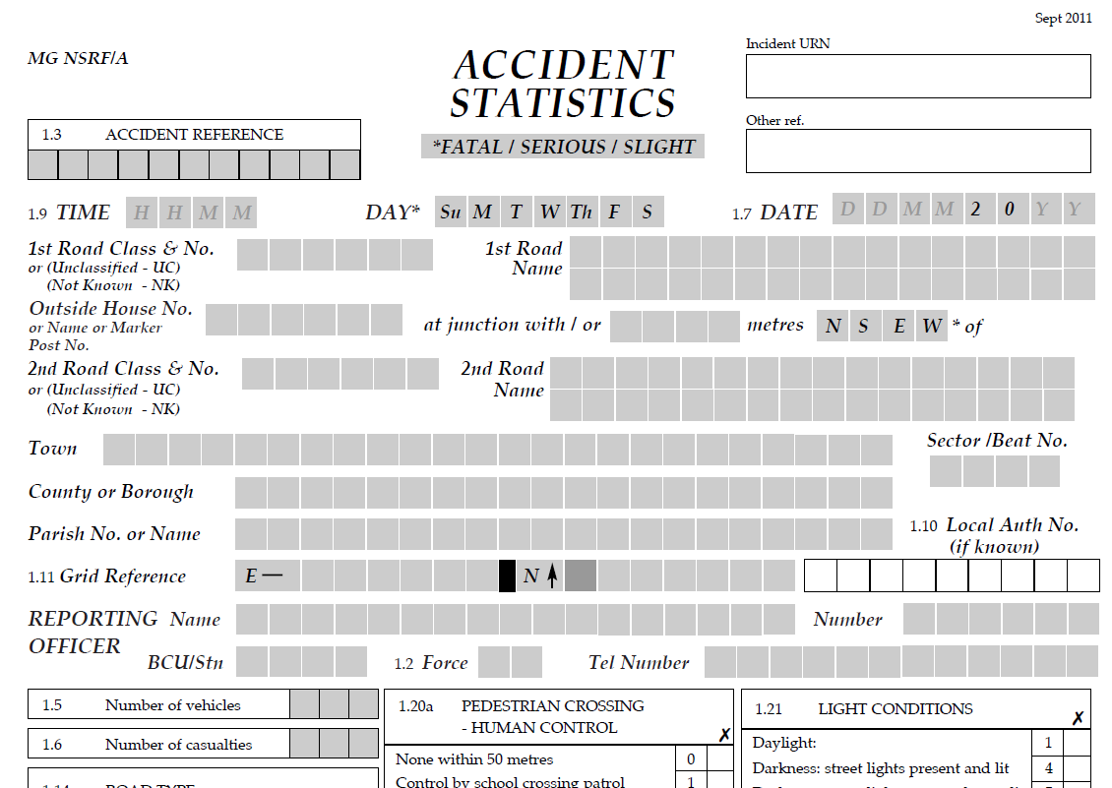
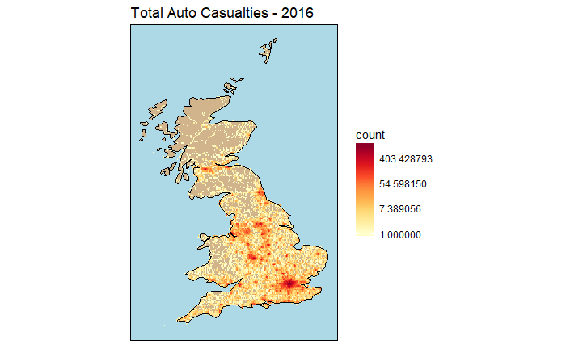
PROBLEM DESCRIPTION
Aaron Wright
Richard Gower
Donald Villarreal
Predict the relative injury severity of an automobile accident (Slight, Severe, and Fatal)
Potential Uses:
Setting insurance loss reserve estimates
Detecting insurance fraud (comparing claim amount with estimate)
Safety and Prevention – advice to people driving in England
Dataset:
Data.gov.uk – Road Safety Data
Police input form:
STATS19: https://www.gov.uk/government/uploads/system/uploads/attachment_data/file/230590/stats19.pdf

Slide 2
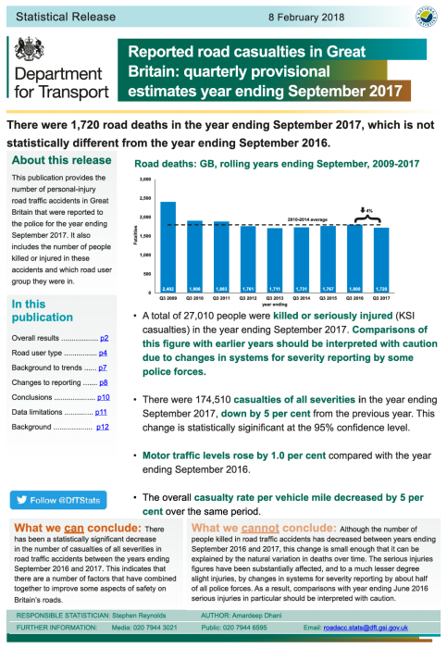
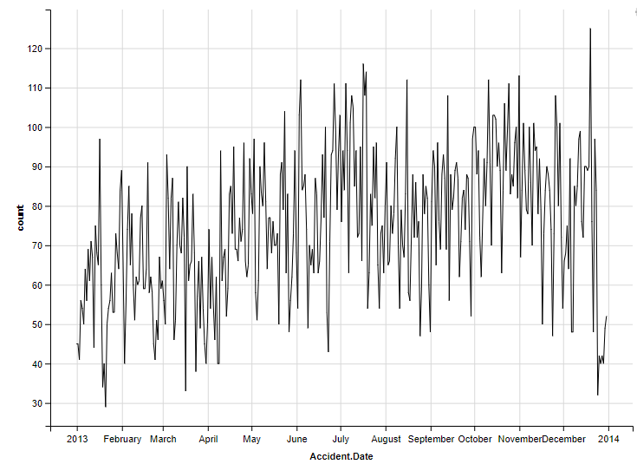
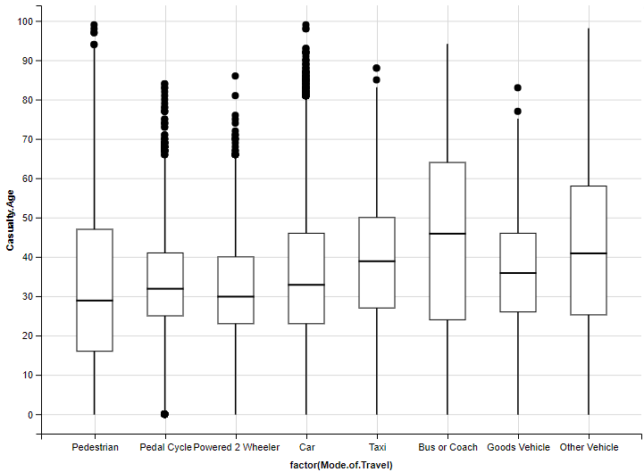
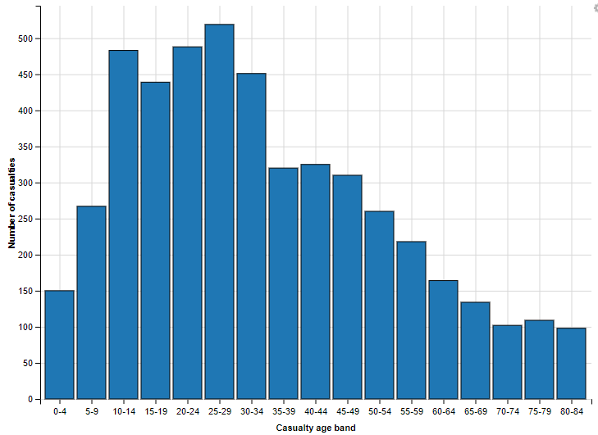
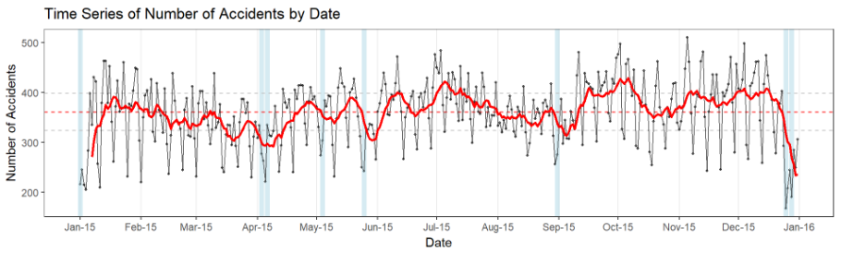
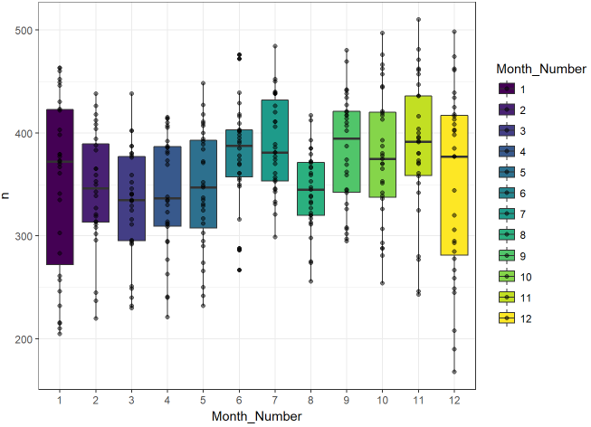
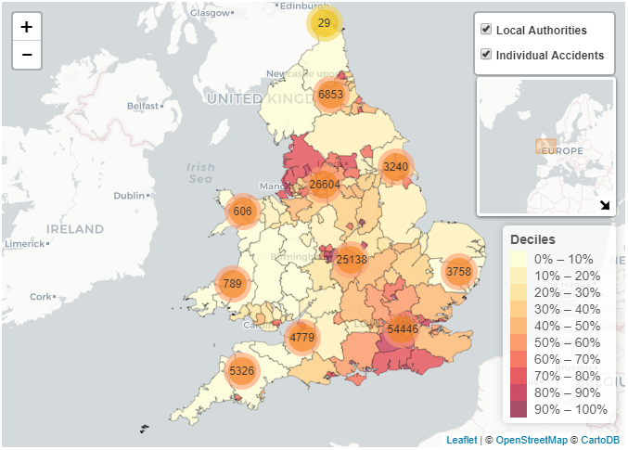
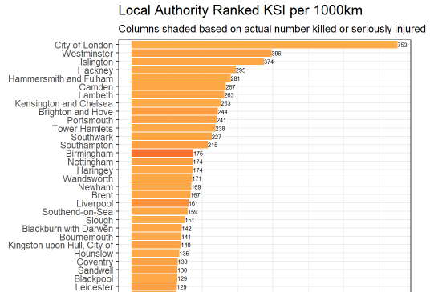
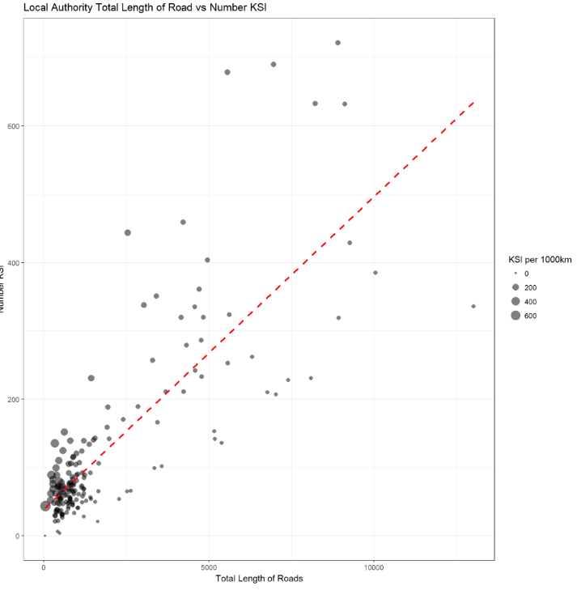
UNIQUENESS OF PROBLEM/APPROACH
Richard Gower
Donald Villarreal
Aaron Wright
Our Approach:
Use several multinomial methods to classify injury severity (slight, severe, and fatal) - team has only done binomial prediction
Predicting severity of injury - not done on the UK data
Research with UK Dataset:
Annual descriptive reports on road accidents (UK DfT)
Modeling impact of weather on road safety 1997-2014 (2014 UK DfT)
Testing for statistically significant changes in road accident and casualty numbers (2014 UK DfT)
Exploratory Data Analysis of 2013 STATS19 casualty data using R and ggvis (Henry Partridge)
Visualization and Casualty Rate per Road Length of 2015 data (2017 Simon Hailstone)
Research papers on accidents:
Predict traffic accident severity in Turkey using 12 input parameters and neural network, genetic algorithm, combined genetic algorithm and pattern search methods (2010)
Predict severity of injuries based on attributes of the road user (1996 O’Donnell & Connor) , severity and duration of traffic accidents (2013 Zong et al), frequency of accidents on rural two-lane highways (2000 USDOT FHA)

Slide 3

EXPECTED CHALLENGES
Donald Villarreal
Aaron Wright
Richard Gower
Requires joining multiple file types with multiple years
Data cleansing
Multinomial models
Expected bias in data
May not be reported to “Bobbies”
Language translation issues
Slipway; dual-carriageway; Pelican, puffin, toucan or similar non-junction pedestrian light crossing; Alighting
In 2016, the severity was impacted by change of reporting
Notes:
This brings us to our expected challenges.
Our first challenge is that we’ll need to join 5 different files with 8 separated years for each file. This is a total of 40 files we’ll have to join.
We also expect to have to do some Data Cleansing on things such as Missing data. Our categorical fields are represented numerically, meaning we’ll have to use a crosswalk to interpret our variable’s values. Additionally, our dates are stored in day, month, year format.
As Richard mentioned earlier, multinomial models are new to us and can provide a challenge. Our predictors also appear to be a majority categorical.
We also expect bias in the data due to accidents without injury possibly not being reported to the “Bobbies”
There are also some language translation issues that you can see on the slide, the most interesting being Pelican, puffin, toucan or similar non-junction pedestrian light crossing
Lastly, the 2016 figures, were affected by a large number of police forces changing their reporting systems during the year. This has had a large impact on the classification of non-fatal number of serious injuries (for severity) recorded in 2016.

